Slide 1
Segmentation of epicardial fat, a cardiovascular risk factor, in the heart, using deep learning
Presented By:
Prerna Singh
Andrew Dupuis
Roshan Sivakumar

Slide 2
Agenda
Background
Clinical Context
Significance
Existing Technical Work
Objectives
Methods
Software
Hardware
Model choice
Preprocessing
Training
Evaluation
AI segmentation Results
SAC Mask Accuracy
EAT Mask Accuracy
Clinical/EAT Results
EAT Volume Accuracy
Comparison to Clinical AG Score
Discussion
Challenges
Future Work
References

Slide 3
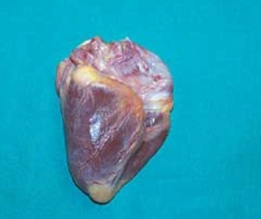
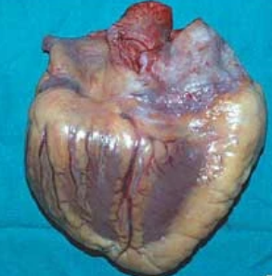
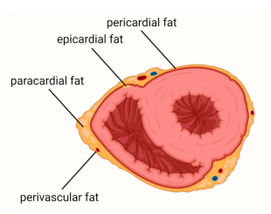
Epicardial adipose tissue (EAT) - Has structural and functional interactions with Heart
Background: Clinical Context
Left: Normal heart (200g), Right: hypertrophic heart (900g) [4]
Classification of adipose tissue around the heart [2]
In normal heart, fat distribution limited to major coronary branches
Hypertrophy is mainly on the right-hand side—the adipose tissue fills the epicardial spaces
EAT has biochemical, mechanical and thermogenic cardioprotective properties – Myocardial homeostasis
No anatomical barrier between EAT and myocardium – Can interact locally

Slide 4
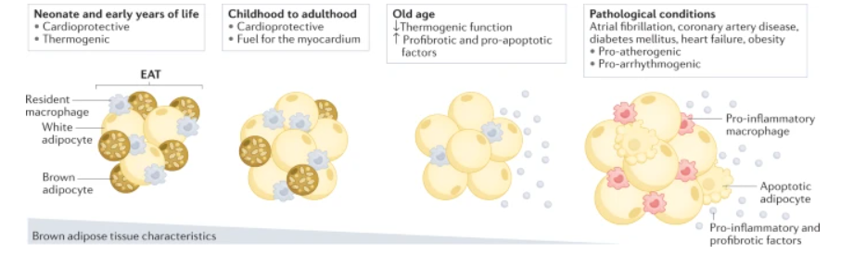
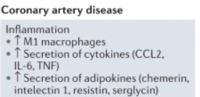
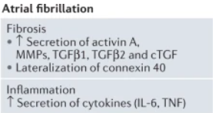
Adverse cardiac diseases and events linked to EAT
Background: Clinical Context
EAT changes with age and in pathological conditions [3]
Under pathological cases, EAT affects heart and coronary arteries via Vasocrine/Pancrine secretion of Cytokines
For conditions like coronary artery disease, diabetes mellitus, heart failure and atrial fibrillation, in EAT:
Thermogenic function decreases
increases in the expression of genes encoding profibrotic and pro-apoptotic factors
EAT can be a therapeutic target
atherogenic - promote the formation of fatty plaques in the arteries
arrhythmogenic - forms a prerequisite for the induction of an arrhythmia
Notes:
notes:

Slide 5
Importance of quantification of EAT Volume
Background: Significance
Risk stratification, Prognostic information, and as a Therapeutic target
Segmentation of EAT volumes is difficult but can assist in clinical workflow
Has an inhomogeneous appearance - different fat densities & artefacts
Examples of use cases:
Support screening/follow-up protocols of patients’ with cardiovascular risk factors
Help cardiologist provide useful indications to modify an inappropriate 'lifestyle'
Help improve the drug treatment with targeted interventions, before and after therapy

Slide 6
Methods to assess EAT volume
Background: Imaging Modalities
MRI, ECG and CT are widely used for quantification of adipose tissue (volume and/or thickness)
CT has higher resolution, more accurate quantification than MRI
Method | Advantages | Challenges
MRI | - No ionizing radiation - Excellent soft tissue contrast | - Large cohorts are less available - Not readily available, high cost - Difficulty in localizing the pericardium in cardiovascular MR
Non-contrast CT calcium score images | - Large cohorts available, since primary screening exam for cardiovascular health | - Slices are thick - No contrast agent for fat boundary definition
High resolution CT angiography (CTA) | Overcomes disadvantages of Non-contrast CT for calcium score | - Large cohorts are less available - Not a screening exam
Image modalities to assess epicardial adipose fat volume
Notes:
hardly visible as a very thin line, typically blurred due to partial volume effects

Slide 7
Manual and Automatic EAT segmentation on CT
Background: Existing Technical Work
Manual Analysis
Time-consuming, requires skilled expertise, prone to inter- and intra-observer variability
Difficult to distinguish thin layer of pericardium tissue in CT scans w/ low contrast
Automatic Methods
Floor of the log clustering algorithm and a set of morphological operations
2D Dense U-Net for automatically segmenting epicardium
3D deep attention U-Net for segmenting the EAT
Dual U-Net framework on 2D images slices
2 CNNs to segment EAT and thoracic adipose tissue (error on top and bottom slices)
Deep Fat Method introduced which overcomes the errors when using 2CNNs to segment EAT

Slide 8
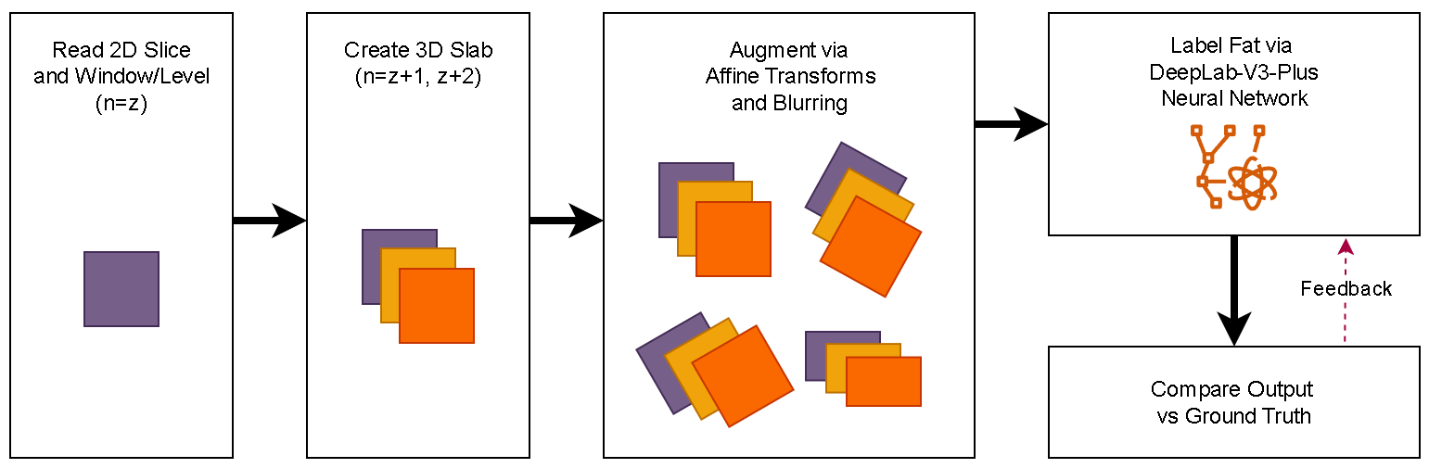
Objectives
Background: Objectives
Deep learning neural network
Preprocessing
Training
Testing/Evaluation
SAC Mask Accuracy
EAT Mask Accuracy
EAT volume accuracy
Notes:
Develop an accurate, fully-automated EAT segmentation from CT calcium score images
Evaluation Metrics
Dice coefficient/F1 score and Intersection over union score
Accuracy
Scatter and Bland–Altman plots (R and p-values) - Not useful, it’s great for comparing two methods

Slide 9
GPU-accelerated workspace
Methods: Hardware
CUDA-accelerated Docker container was created
Provides portability of the test environment, and enhances reproducibility
Allows local development while supporting cloud/cluster deployment
Initial training was completed locally on a Windows 10 machine with 8c/16t Intel i7 Processor, 32Gb RAM, nVidia GTX1080 GPU
Time per epoch: ~12 minutes
Total training time: ~6 hours
Final training was accelerated via Azure cloud infrastructure, with 128c/256t Intel Xeon Processor, 2Tb RAM, 4xnVidia T100 GPU
Time per epoch: ~19 seconds
Total training time: ~9 minutes

Slide 10
2D U-Net
Methods: Model Choice
3x
4x
Input
Conv2D
MaxPool
Conv2D
Dropout
MaxPool
Conv2D
Dropout
upsample
Conv2D
Conv2D
Output
Based on the paper, we used a 2D U-net, although technically, we inputted 3D volumes (n-1, n, n+1 slices).
U-Net is a convolutional neural network architecture that is designed for segmentation of images
Input size: (256,256,3)
Output size: (256, 256, 3): cardiac sac probability mask

Slide 11
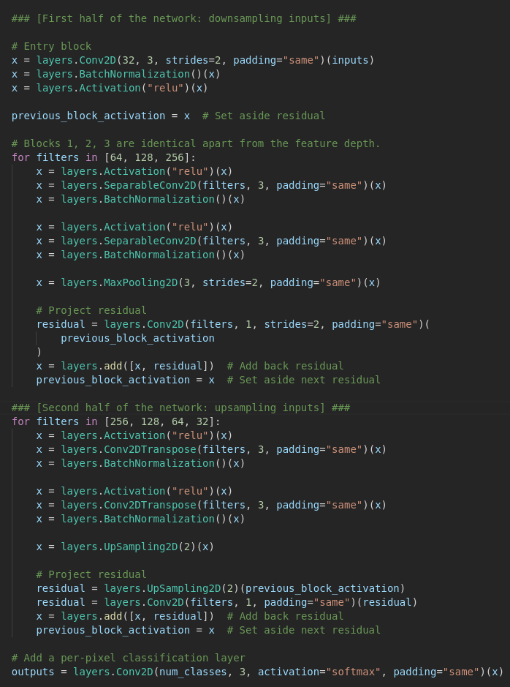
2D U-Net
Methods: Model Choice
3x
4x
Input
Conv2D
MaxPool
Conv2D
Dropout
MaxPool
Conv2D
Dropout
upsample
Conv2D
Conv2D
Output
Based on the paper, we used a 2D U-net, although technically, we inputted 3D volumes (n-1, n, n+1 slices).
U-Net is a convolutional neural network architecture that is designed for segmentation of images
Input size: (256,256,3)
Output size: (256, 256, 3): cardiac sac probability mask
Notes:
If needed, here’s the underlying

Slide 12
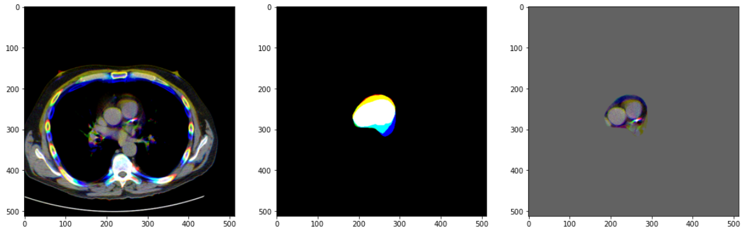
Data and Preprocessing
Methods: Preprocessing
window/leveled and masked image of the RGB data
CT scans:
40 non-contrast cardiac CT images
2D slice dimensions : 512x512, axial thickness : 2.5mm
Pre-processing training and testing data:
Hu attention window with a window/level of 350/40 HU

Slide 13
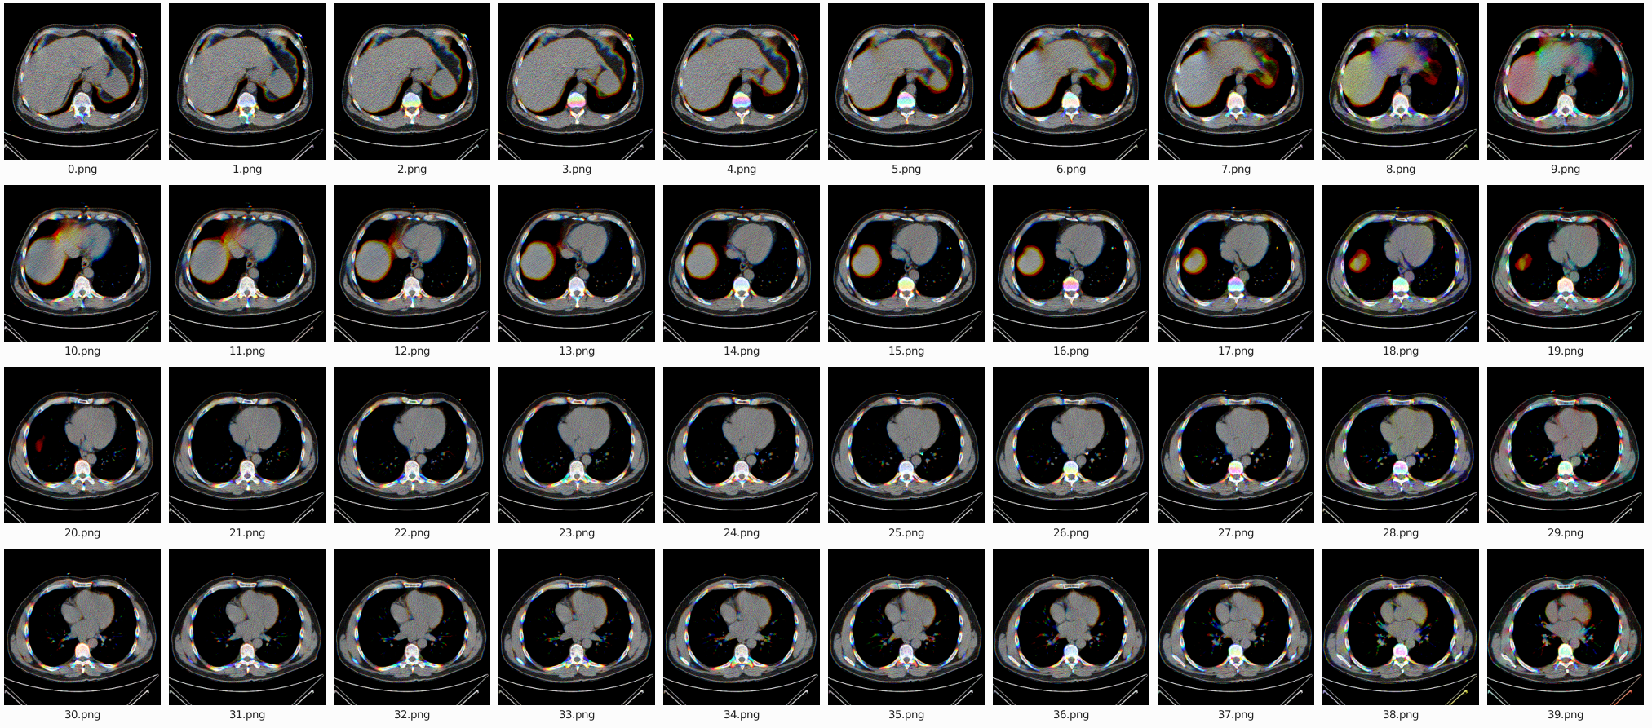

Slide 14
Data Augmentation; Train/Validate/Test Split
Methods: Training
Training/Validation Set Size: 32/4 volumes/patients (80%/10%)
Testing Set Size: 4 volumes/patients (10%)
Data Augmentation: via data generator in keras
parameters: rotation_range=0.2, width_shift_range=0.05, height_shift_range=0.05, shear_range=0.05, zoom_range=0.05, horizontal_flip=True, fill_mode='nearest'

Slide 15
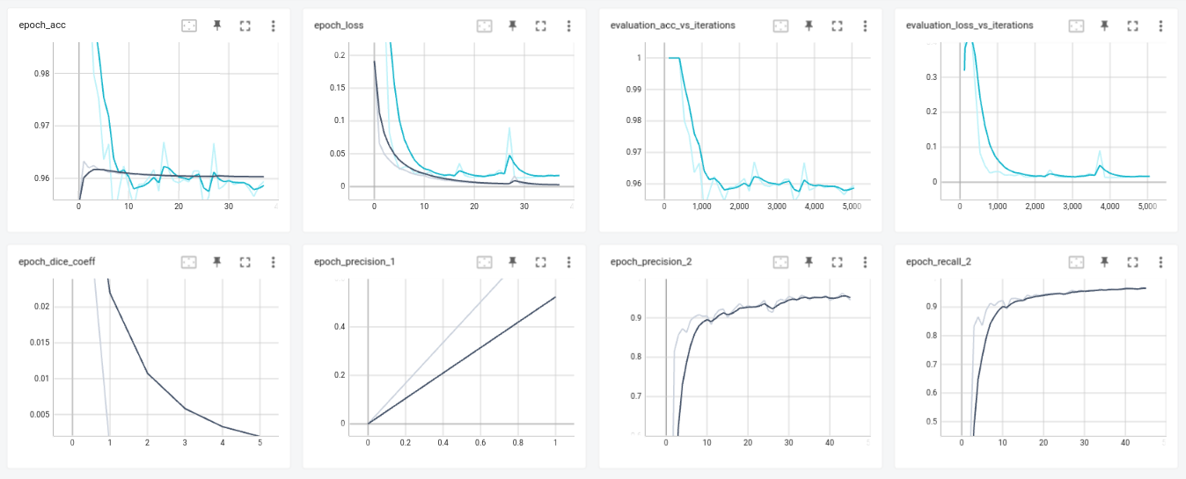
Evaluation of Model Training
Methods: Evaluation
Integrated with TensorBoard model training dashboard for performance tracing and debugging of training runs

Slide 16
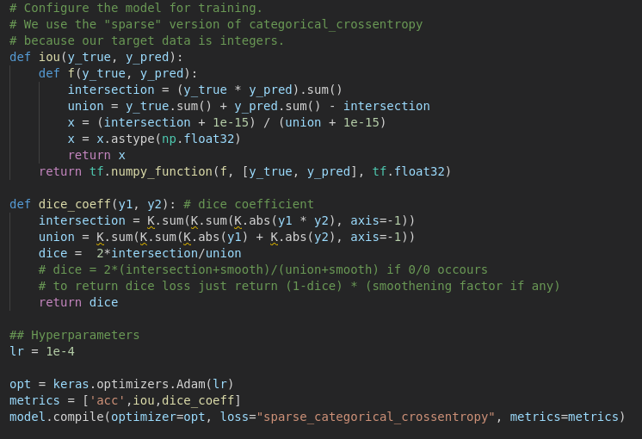
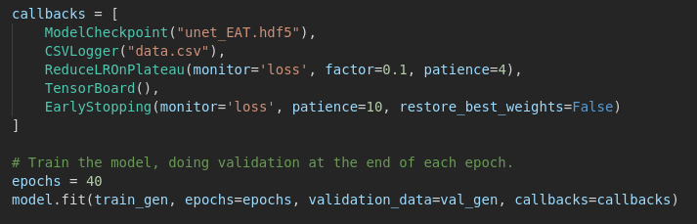
Evaluation of Model Training
Methods: Evaluation
Variable learning rate and early stopping based on loss stagnation over epochs
Integrated with TensorBoard model training dashboard for performance tracing and debugging of training runs

Slide 17
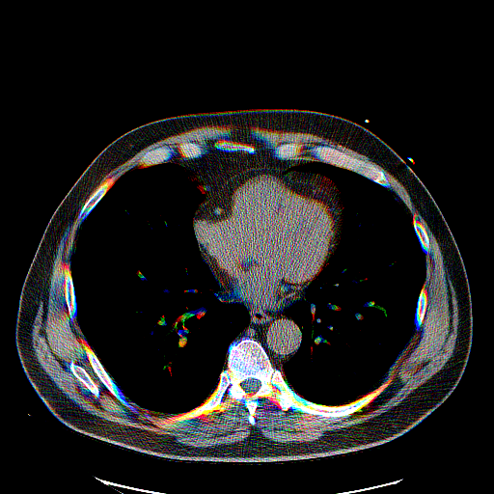


Pericardial Sac Mask Accuracy
AI segmentation Results: Sac Mask Accuracy
Source Reference/Manual AI/UNet

Slide 18
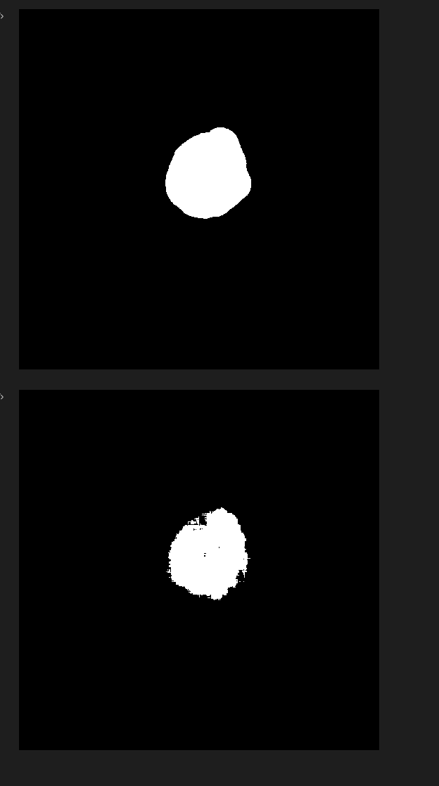
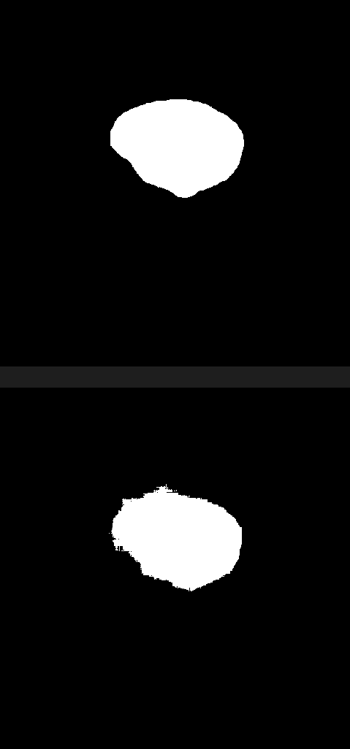
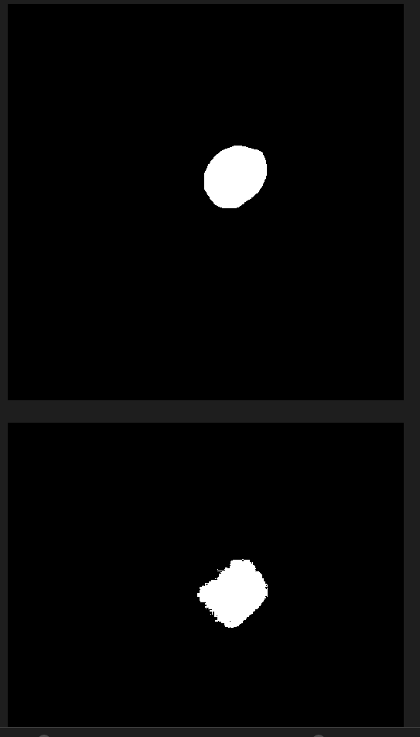
Pericardial Sac Mask Accuracy
AI segmentation Results: Sac Mask Accuracy
Majority of slices show very good agreement (>91%) between the UNet segmentation implementation vs manually-segmented reference.
(note detail differences, edge sharpness)
Reference
AI Result

Slide 19
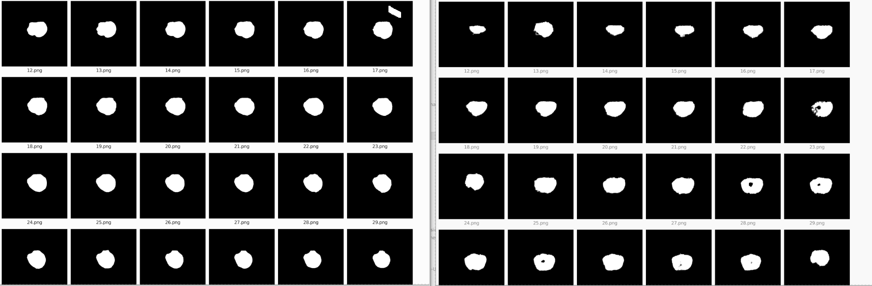
Pericardial Sac Mask Accuracy

Slide 20
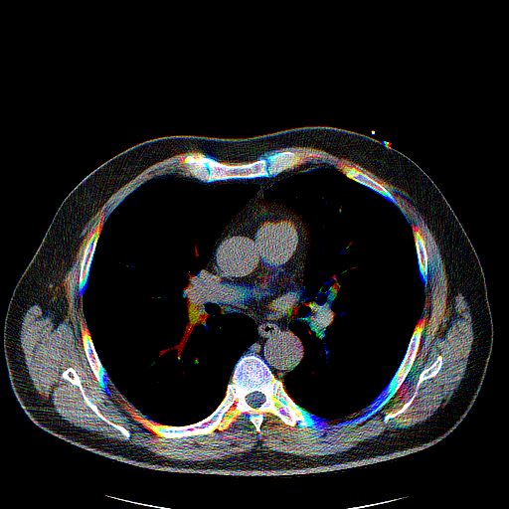


Pericardial Sac Mask Accuracy
AI segmentation Results: Sac Mask Accuracy
Source Reference/Manual AI/UNet
Performance is inconsistent - other slices show deep disagreement. This is likely due to having run too few epochs to adequately account for differences in anatomy

Slide 21
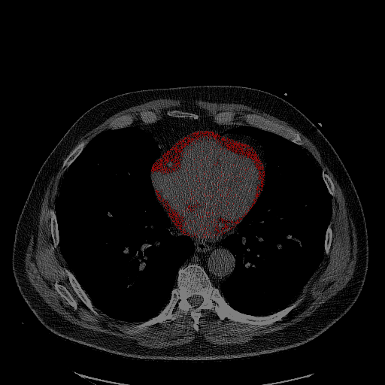
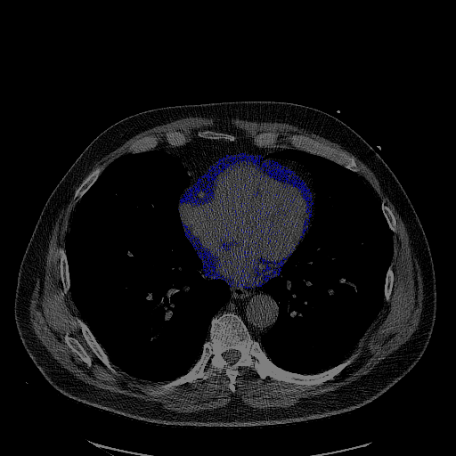
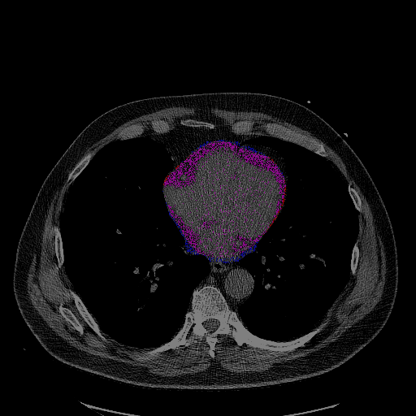
EAT Mask Accuracy
AI segmentation Results: EAT Mask Accuracy
Reference/Manual AI/UNet Comparison
Most slices show good agreement (~88%) between the UNet segmentation implementation and the manually-segmented reference

Slide 22
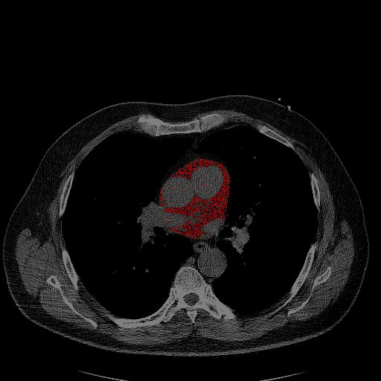
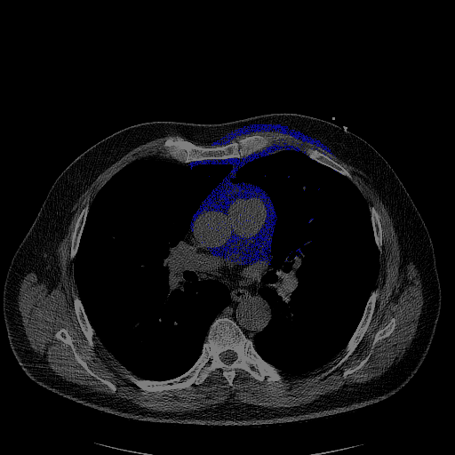
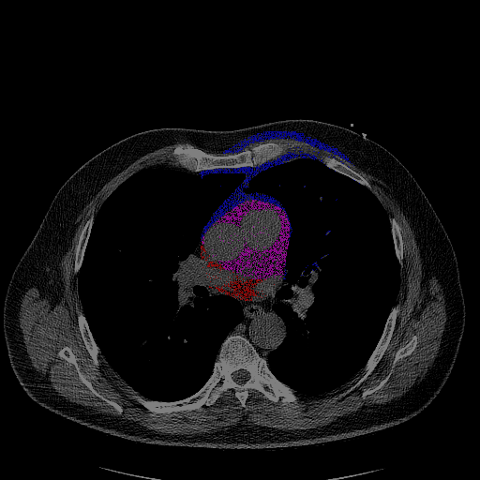
EAT Mask Accuracy
AI segmentation Results: EAT Mask Accuracy
Reference/Manual AI/UNet Comparison
When Sac Performance is inconsistent - slices show very only partial agreement (~61%) between the UNet segmentation implementation and the manually-segmented reference

Slide 23
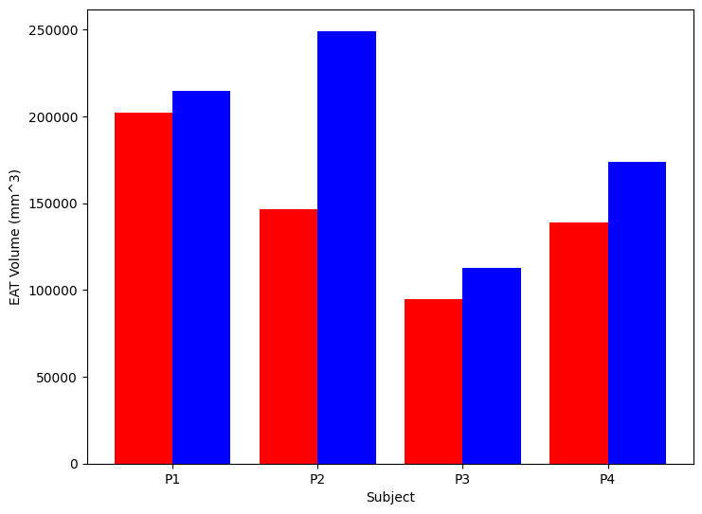
EAT Volume Accuracy
Clinical Results: EAT Volume Accuracy
36 datasets were used as training, with four as test sets
Comparing total volume of reference versus AI EAT masks via voxelwise summation
Volume accuracy varied widely across datasets:
P1: +/- 5.45%
P2: +/- 70.28%
P3: +/- 7.93%
P4: +/- 16.12%
P2’s acquisition was collected in a substantially different view (slice selection), which likely contributes to the errors seen

Slide 24
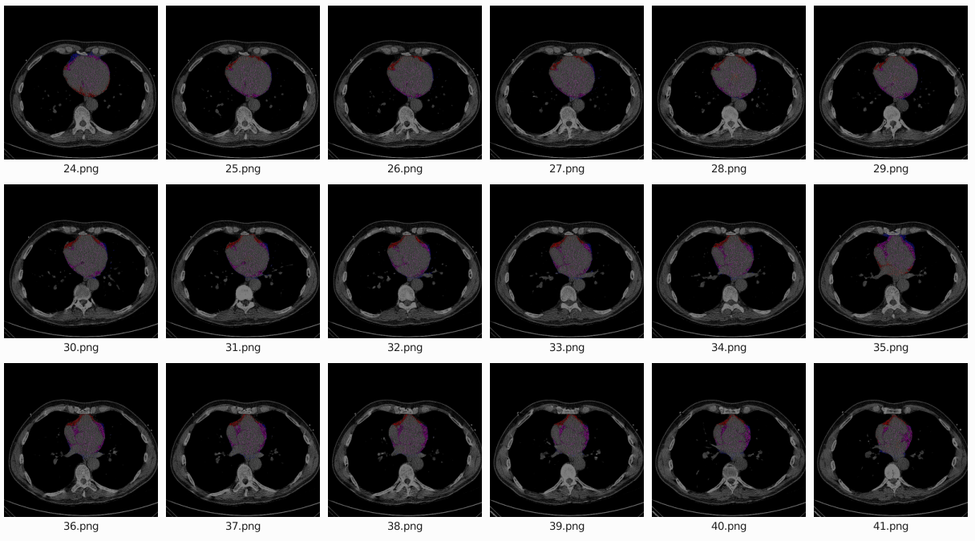
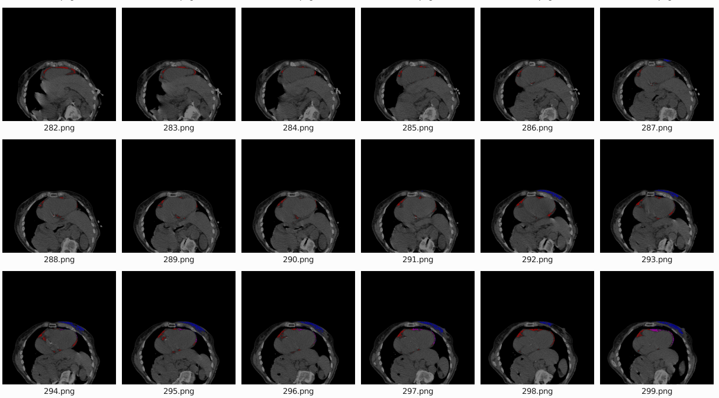
EAT Volume Accuracy
Clinical Results: EAT Volume Accuracy
Good Performer (P1)
Bad Performer (P2)
Test dataset with poorest volume accuracy performance had major offsets in
slice position and FOV (well beyond +/- 5% data augmentation limits)

Slide 25
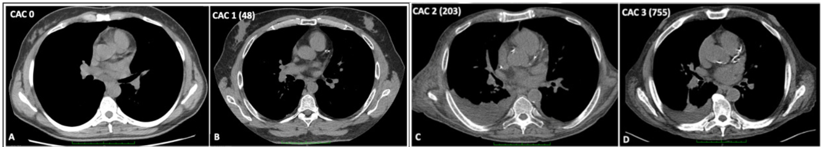
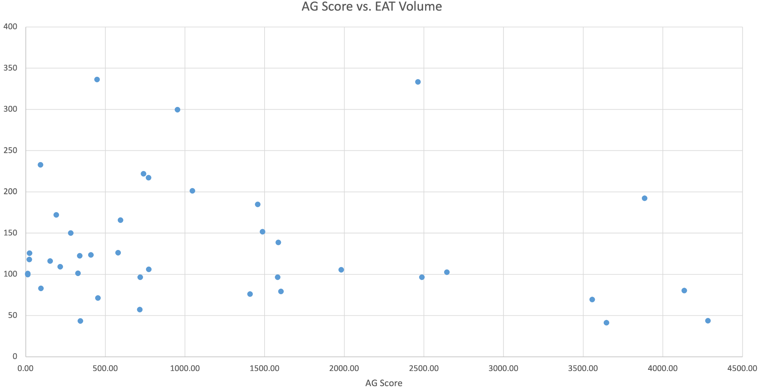
Clinical AG Score Correlation
Clinical Results: Comparison to Clinical AG Score
Example CT Calcium Score images [5]
Clinical AG Score (Agatston score): method to
stratify the risk for a major adverse cardiac event for patients via non-contrast CT calcium scoring
Calculated based on a weighted density score given to the highest attenuation value (HU) multiplied by the area of the calcification, for all calcifications in the image

Slide 26
Discussion: Challenges
Discussion: Challenges
Model parameter tuning
Evaluating cost functions
Segmentation loss functions
Unbalanced classes

Slide 27
Future work
Discussion: Future Work
Review of automated results required to investigate errors identified (ex: outliers)
Model hyperparameter optimization
3D U-Net implementation
Region-growing approach to pericardial sac segmentation

Slide 28
References
Goel, A., Knipe, H. Agatston score. Reference article, Radiopaedia.org. (accessed on 18 Apr 2022) https://doi.org/10.53347/rID-30926
Konwerski, M., Gąsecka, A., Opolski, G., Grabowski, M., & Mazurek, T. (2022). Role of Epicardial Adipose Tissue in Cardiovascular Diseases: A Review. Biology, 11(3), 355.
Iacobellis, G. (2022). Epicardial adipose tissue in contemporary cardiology. Nature Reviews Cardiology, 1-14.
Iacobellis, G., Corradi, D., & Sharma, A. M. (2005). Epicardial adipose tissue: anatomic, biomolecular and clinical relationships with the heart. Nature clinical practice Cardiovascular medicine, 2(10), 536-543.
Zorzi, A., Brunetti, G., Cardaioli, F., D'Arcangelo, F., Fabris, T., Gambato, M., ... & Pontisso, P. (2021). Coronary artery calcium on standard chest computed tomography predicts cardiovascular events after liver transplantation. International Journal of Cardiology, 339, 219-224.

Slide 29
Thank You
Questions?

